Slide 1
Object Oriented Programming I: Lecture 2
Ahmed Imteaj
Lecturer
Dept. of CSE, IIUC

Slide 2
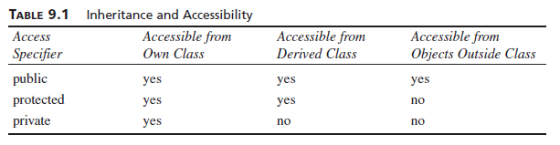
Access Specifiers

Slide 3
Assigning Objects
#include <iostream>
class Test{
public:
int i;
};
int main(){
Test c;
c.i = 1;
Test d = c;
d.i = 2;
std::cout << "Value: " << c.i << "\n"<<"Value:"<<d.i;
}
Output:
Value: 1
Value: 2

Slide 4
Passing Objects to Functions
Objects may be passed to functions in just the same way that any other type of variable can.
Objects are passed to functions through the use of the standard call-by value mechanism.

Slide 5

Passing Objects to Functions
#include <iostream>
using namespace std;
class myclass {
int i;
public:
myclass(int n);
~myclass();
void set_i(int n) { i=n; }
int get_i() { return i; }
};
myclass::myclass(int n)
{
i = n;
cout << "Constructing " << i << "\n";
}
myclass::~myclass()
{
cout << "Destroying " << i << "\n";
}
void f(myclass ob);
int main()
{
myclass o(1);
f(o);
cout << "This is i in main: ";
cout << o.get_i() << "\n";
return 0;
}
void f(myclass ob)
{
ob.set_i(2);
cout << "This is local i: " << ob.get_i();
cout << "\n";
}
Output:

Slide 6
Returning Objects
#include <iostream>
using namespace std;
class myclass {
int i;
public:
void set_i(int n)
{i=n;}
int get_i()
{return i;}
};
myclass f(); // return object of type myclass
int main()
{
myclass o;
o = f();
cout << o.get_i() << "\n";
return 0;
}
myclass f()
{
myclass x;
x.set_i(1);
return x;
}
Output: 1

Slide 7
Returning Objects
Self H.W.
Balagurusamy 130page (4th edition) Returning objects 5.16

Slide 8

Constructor and Destructor
A constructor function is a special function that is a member of a class and has the same name as that class.
Constructors are special class functions which performs initialization of every object. The Compiler calls the Constructor whenever an object is created.

Slide 9
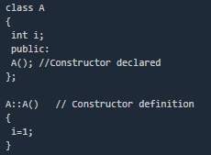
Constructor and Destructor
While defining a constructor you must remember that the name of constructor will be same as the name of the class, and constructors never have return type.
Constructors can be defined either inside the class definition or outside class definition using class name and scope resolution :: operator.

Slide 10
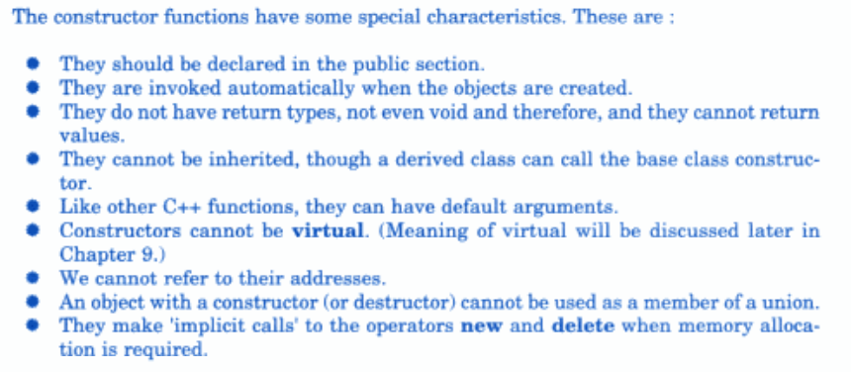
Characteristics of Constructor
The constructor functions have some special characteristics.
See reference book→Balagurusamy(page 146)

Slide 11
Types of Constructors
Constructors are of three types :
Default Constructor
Parameterized Constructor
Copy Constructor
Default Constructor
Default constructor is the constructor which doesn't take any argument. It has no parameter.
Syntax :
class_name () { Constructor Definition }

Slide 12
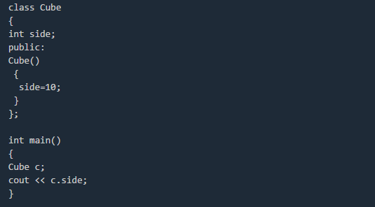
Default Constructor
Output : 10
In this case, as soon as the object is created the constructor is called which initializes its data members.
A default constructor is so important for initialization of object members, that even if we do not define a constructor explicitly, the compiler will provide a default constructor implicitly.

Slide 13
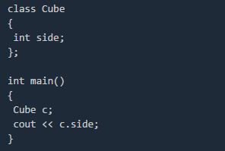
Default Constructor
Output : 0
In this case, default constructor provided by the compiler will be called which will initialize the object data members to default value, that will be 0 in this case.

Slide 14
Parameterized Constructor
These are the constructors with parameter. Using this Constructor you can provide different values to data members of different objects, by passing the appropriate values as argument.

Slide 15
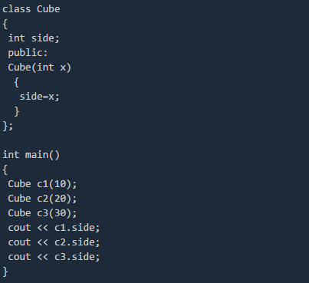
Parameterized Constructor
OUTPUT : 10 20 30

Slide 16
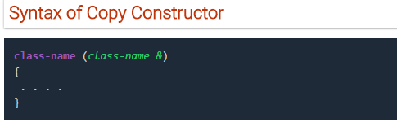
Copy Constructor
These are special type of Constructors which takes an object as argument, and is used to copy values of data members of one object into other object.
It is usually of the form X (X&i), where X is the class name.

Slide 17
Copy Constructor
A copy constructor is used to declare and initialize an object from another object. For example, the statement
integer I2(I1);
would define the object I2 and at the same time initialize an object from another object. Another form of this statement is
integer I2=I1;
When no copy constructor is defined, the compiler supplies its own copy constructor.

Slide 18

Copy Constructor
#include<iostream>
using namespace std;
class code
{
int id;
public:
code(){}
code(int a)
{id=a;}
code (code &x)
{
id=x.id;
}
void display (void)
{cout<<id;}
};
int main()
{
code A(100);
code B(A); //copy constructor called
code C=A; //copy constructor called again
code D;
D=A; //copy constructor not called
cout<<"\n id of A: "; A.display();
cout<<"\n id of B: "; B.display();
cout<<"\n id of C: "; C.display();
cout<<"\n id of D: "; D.display();
return 0;
}
Output:

Slide 19
Constructor Overloading
Just like other member functions, constructors can also be overloaded. In fact when you have both default and parameterized constructors defined in your class you are having Overloaded Constructors, one with no parameter and other with parameter.
You can have any number of Constructors in a class that differ in parameter list.
In the code of next slide, if we write Student S; in main(), it will lead to a compile time error, because we haven't defined default constructor and compiler will not provide its default constructor because we have defined other parameterized constructors.

Slide 20
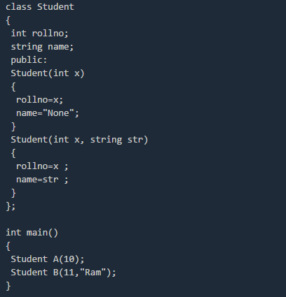
Constructor Overloading

Slide 21
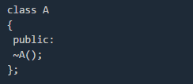
Destructor
Destructor is a special class function which destroys the object as soon as the scope of object ends. The destructor is called automatically by the compiler when the object goes out of scope.
The syntax for destructor is same as that for the constructor, the class name is used for the name of destructor, with a tilde ~ sign as prefix to it.
Destructors will never have any arguments.

Slide 22
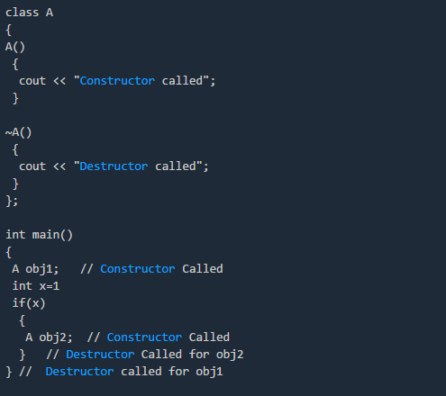
Example to see how Constructors and Destructors are called

Slide 23
Thank You!!

